Slide 1

Hello World 2025
September 21, 2025
boilergains: for the everyday student
Heer Mehta, Manaswini Singh, Yutika Sawant

Slide 2


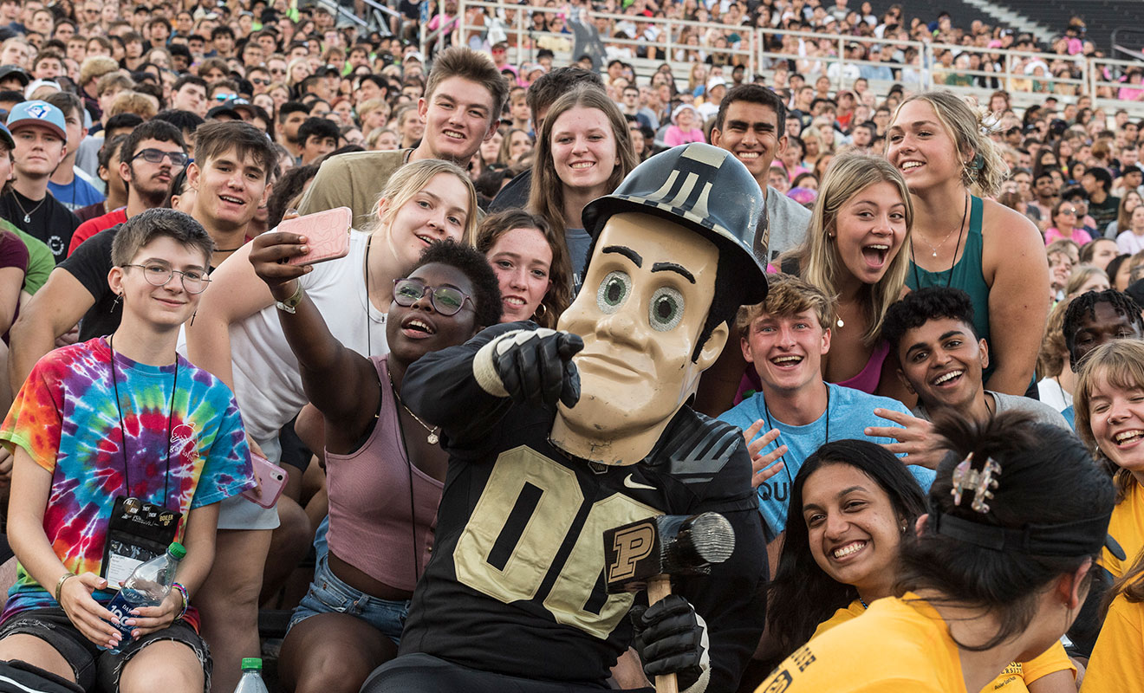


Why?
Personal story
Prioritize students’ Health and Wellness
“...optimization and choices of dietary structure becoming key factors affecting their physical and mental development”
Notes:
Over 25,000 students engage in fitness activities at Purdue, highlighting a strong interest in wellness among our student population, and around 15,000 students utilize meal plans in some capacity.

Slide 3
What to expect?
Features:
Add personal details to get recommended nutritional values
Use those or pick your own
Choose a dining court
Add dietary preferences
Get a list of suggested meals

Slide 4

Future Plans
Web Scraping for a dynamic database
Date + Meal period
Ingredients, Sodium, Cholesterol
Number of meals/day customization
Include more allergen tags & preferences
Add MYO bars + “Save room for dessert”
Better combinatorial algorithm
Supplement Purdue Dining Menus
Notes:
more accessible by incorporating allergen-specific filters and offering nuanced dietary options such as vegetarian, halal, and other alternatives at each dining court. It should account for niche sections like salad bars, make-your-own pizza, and sizzling pasta stations, while also allowing users to customize individual meals—dividing portions based on whether they eat two or three meals a day. Features like meal time selection, saving room for desserts to manage calories, and web scraping for up-to-date menu data would create a more flexible and personalized experience.

